Slide 1
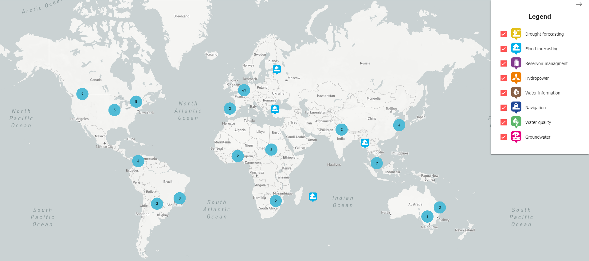
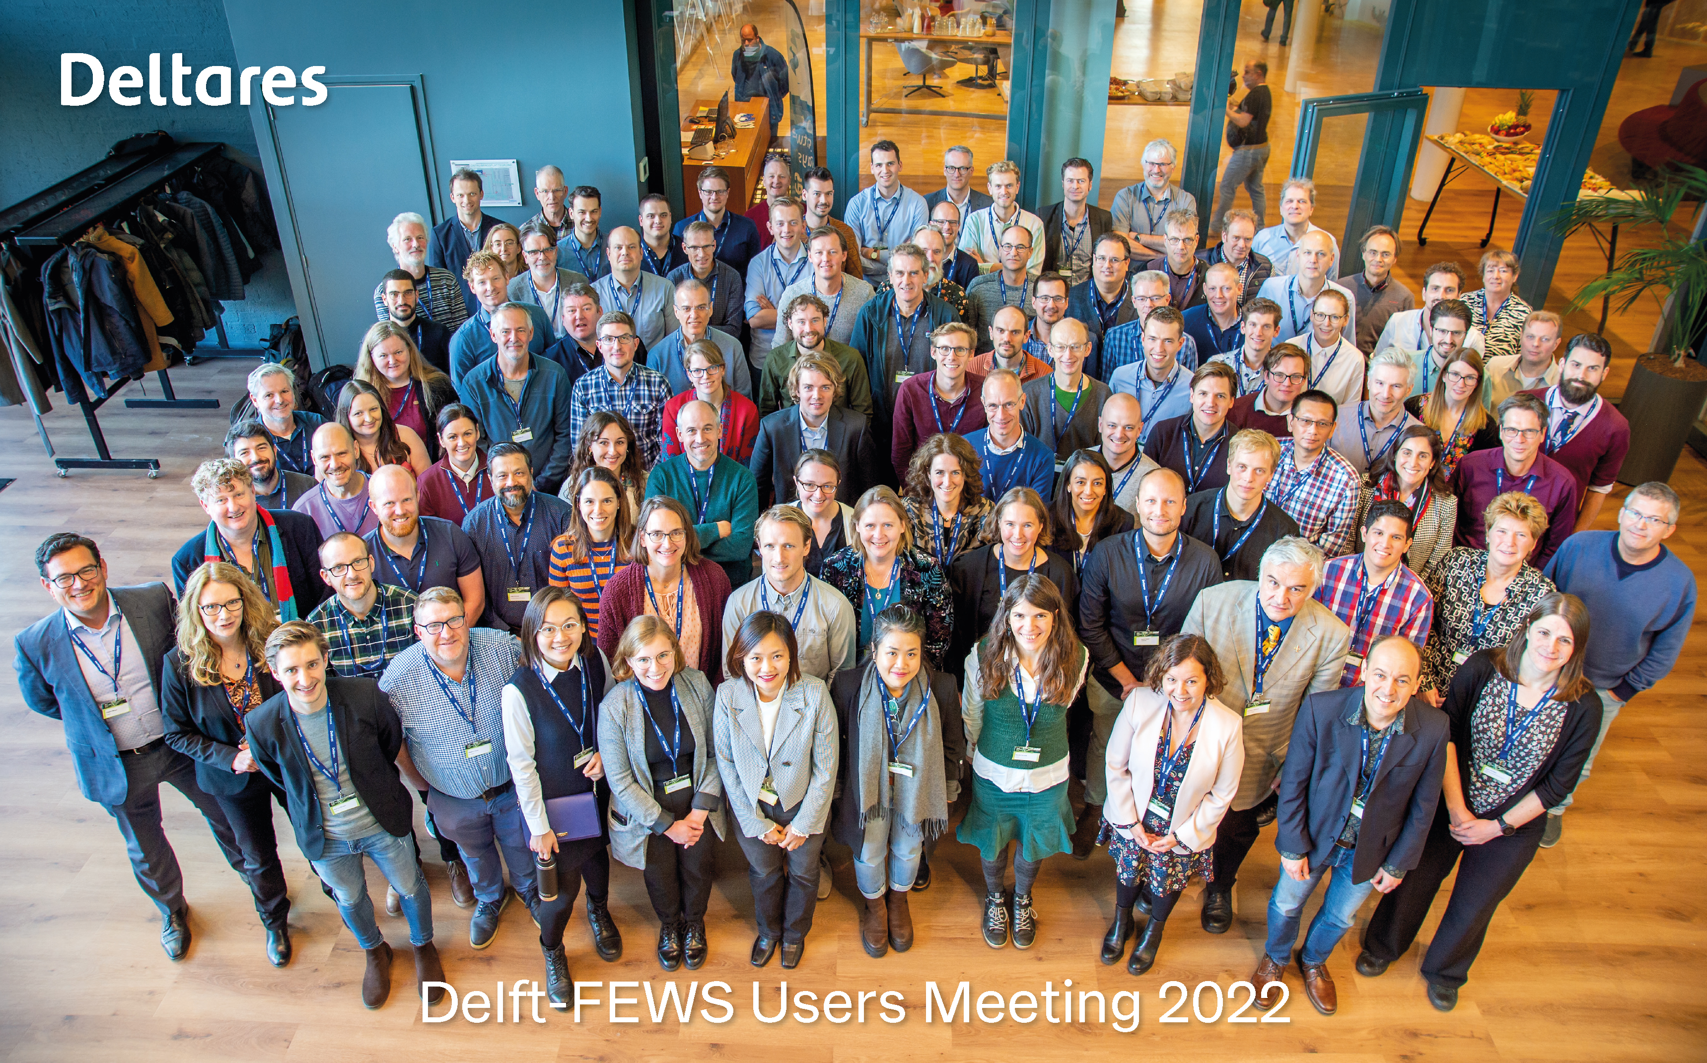
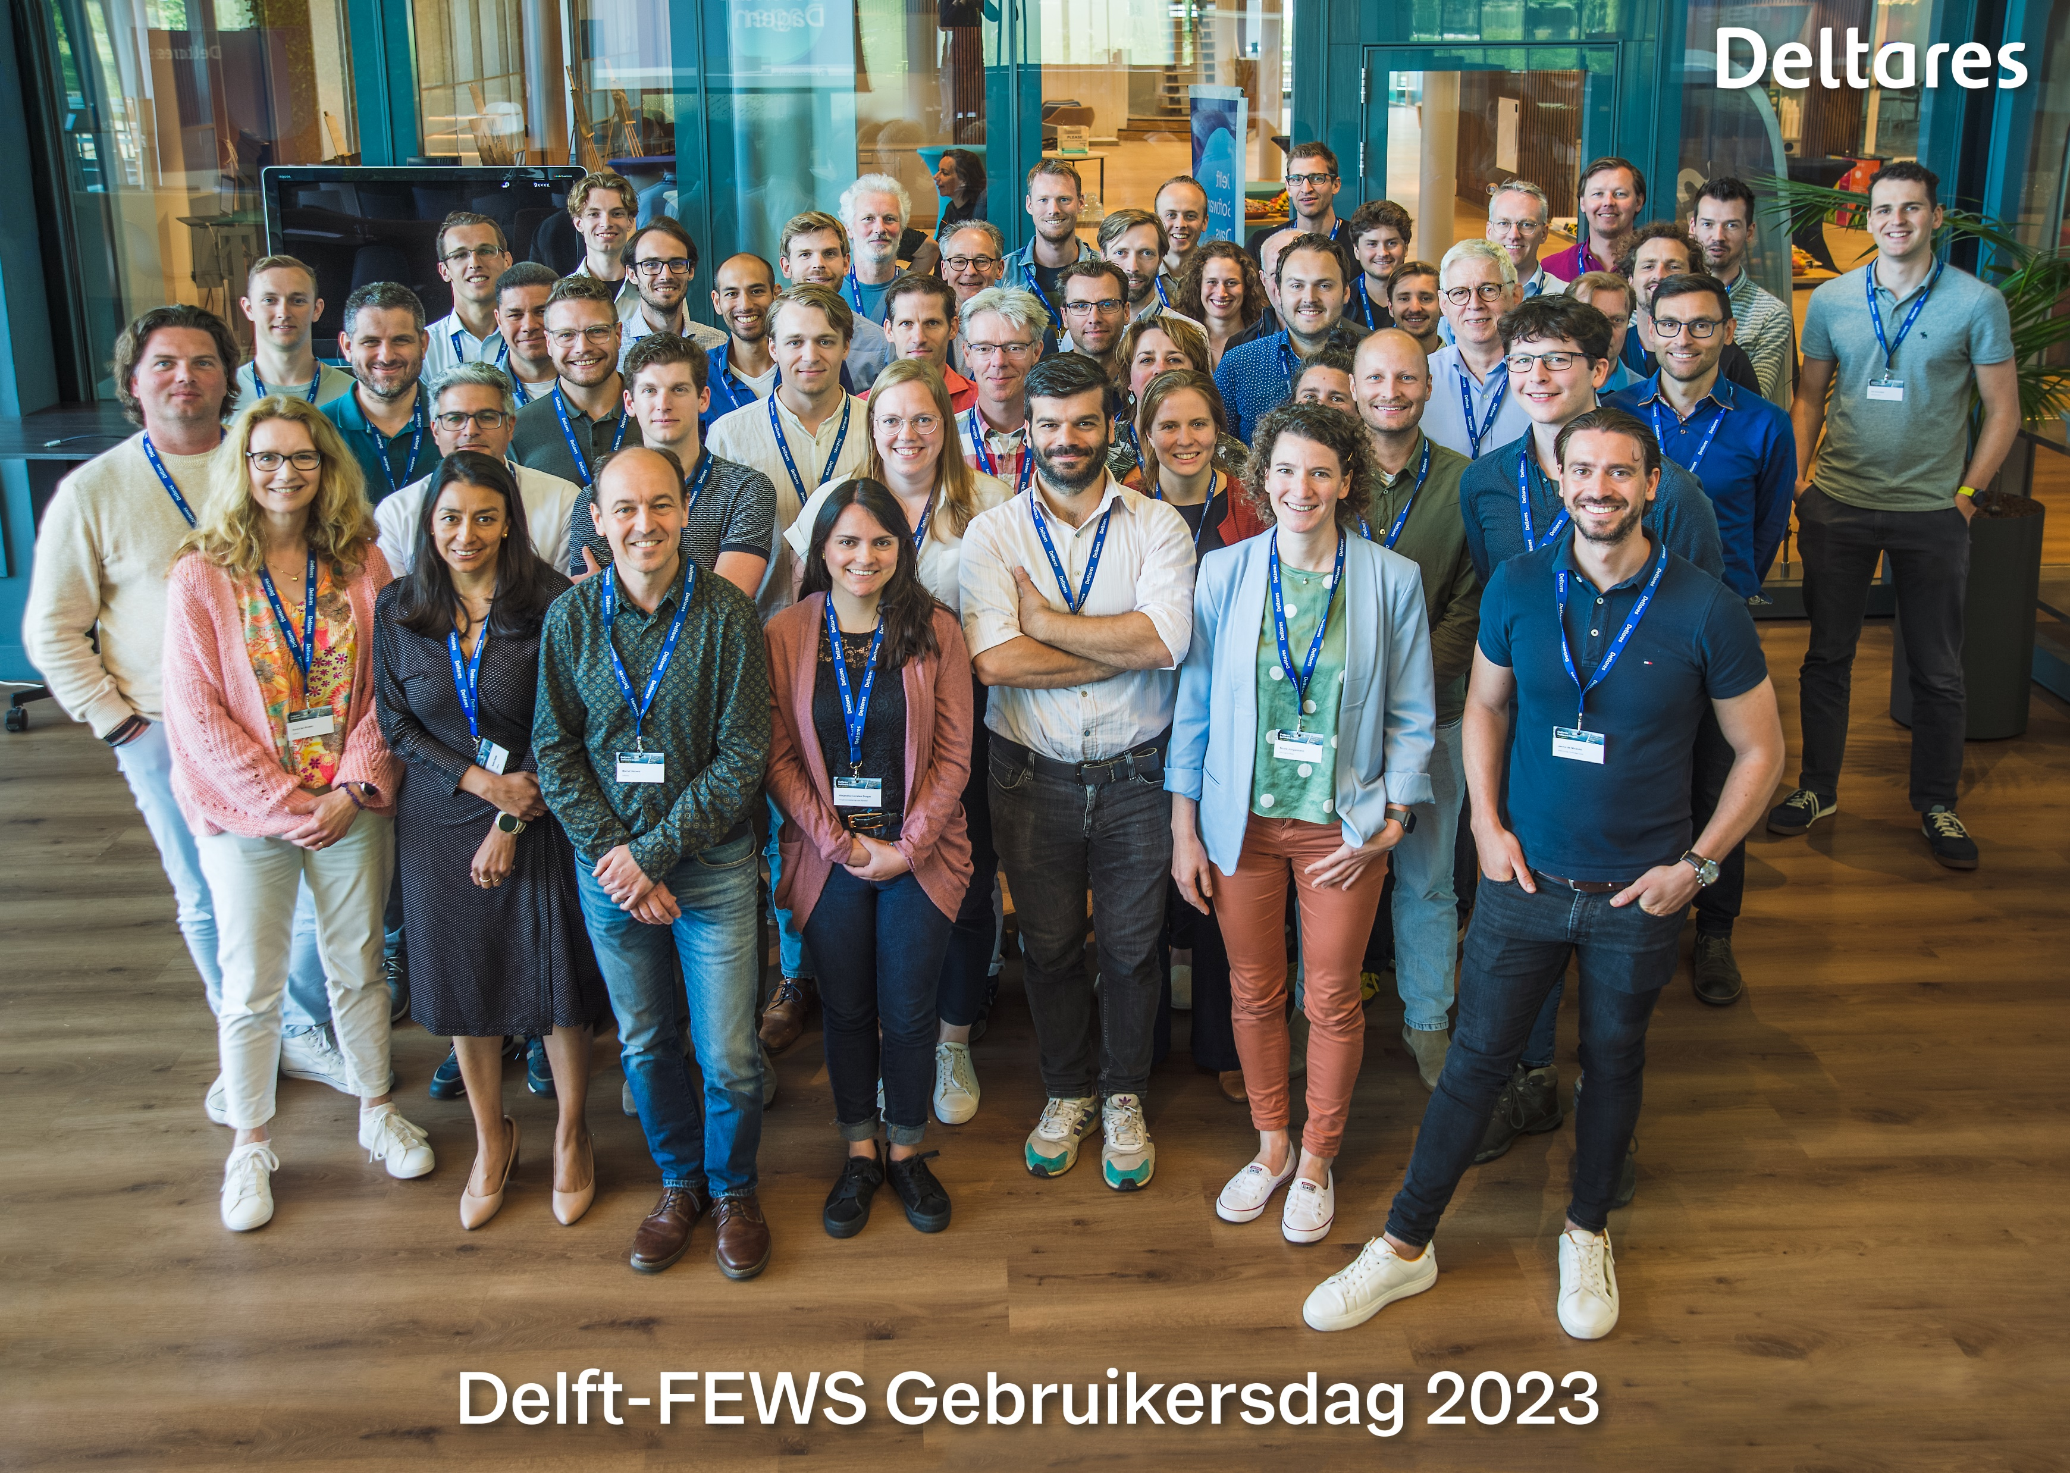
Delft-FEWS
Community Talk #4
WIS Systems
Hosted by: Roger de Crook (HDSR)

Slide 2
Programme
Welcome and Introductions (Roger de Crook, HDSR)
Update from Delft-FEWS Product Management (Gerben Boot, Deltares)
Main topic: FEWS as Water Information System … in different flavors (Roger de Crook, HDSR)
Questions and Discussion (Roger de Crook, HDSR)
Wrap up and conclusions (Gerben Boot, Deltares)
Close
Notes:
Start Teams meeting and invite participants to say hello in the chat – Ilonka/Gerben/Roger
9:00 Start recording – Gerben (because Ilonka has to leave early..) Welcome, introduction event (slide with program) - Roger
9:05 update FEWS product management - Gerben
9:10 Introduction to “What is a Waterboard” – Roger
9:13 First part of presentation: “Water quantity” - Roger (15 min presentation, 5 min for one or two questions)
Monitor the chat and initiate questions - Gerben
9:33 Second part of presentation: “Water quality” (5 min talk, 5 min for one or two questions)
9:43 Quick summary – Roger
9:45 Community discussion, respond to questions in the chat
9:57 Wrap up, thank you, refer to the portal for the recording – Roger
10:00 End meeting, stop recording.
Monitor the chat for a bit to answer the remaining questions

