Slide 1
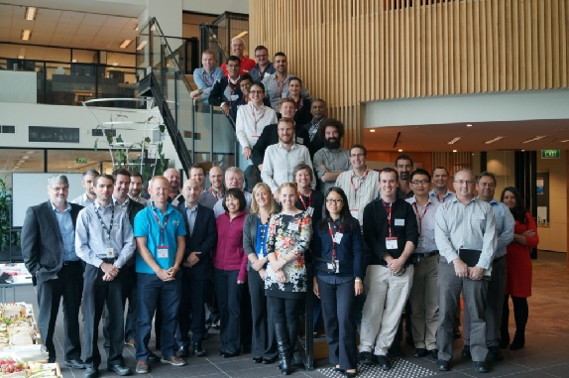
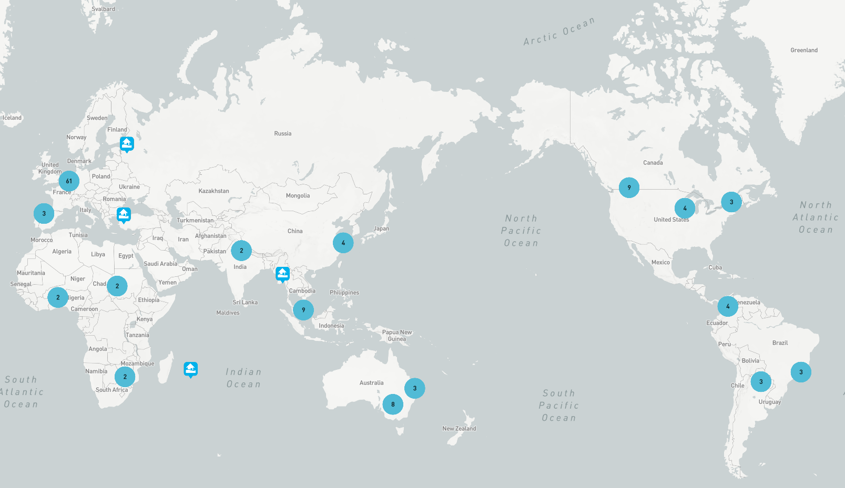
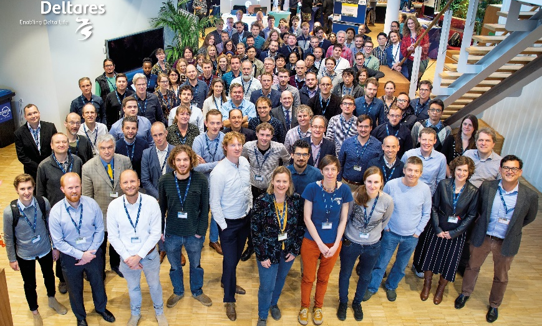
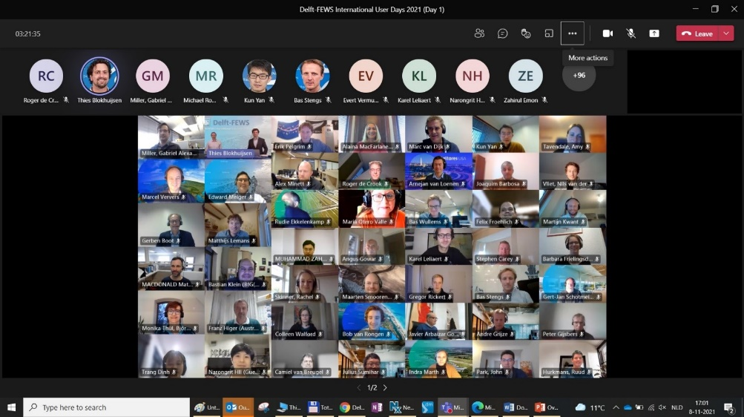
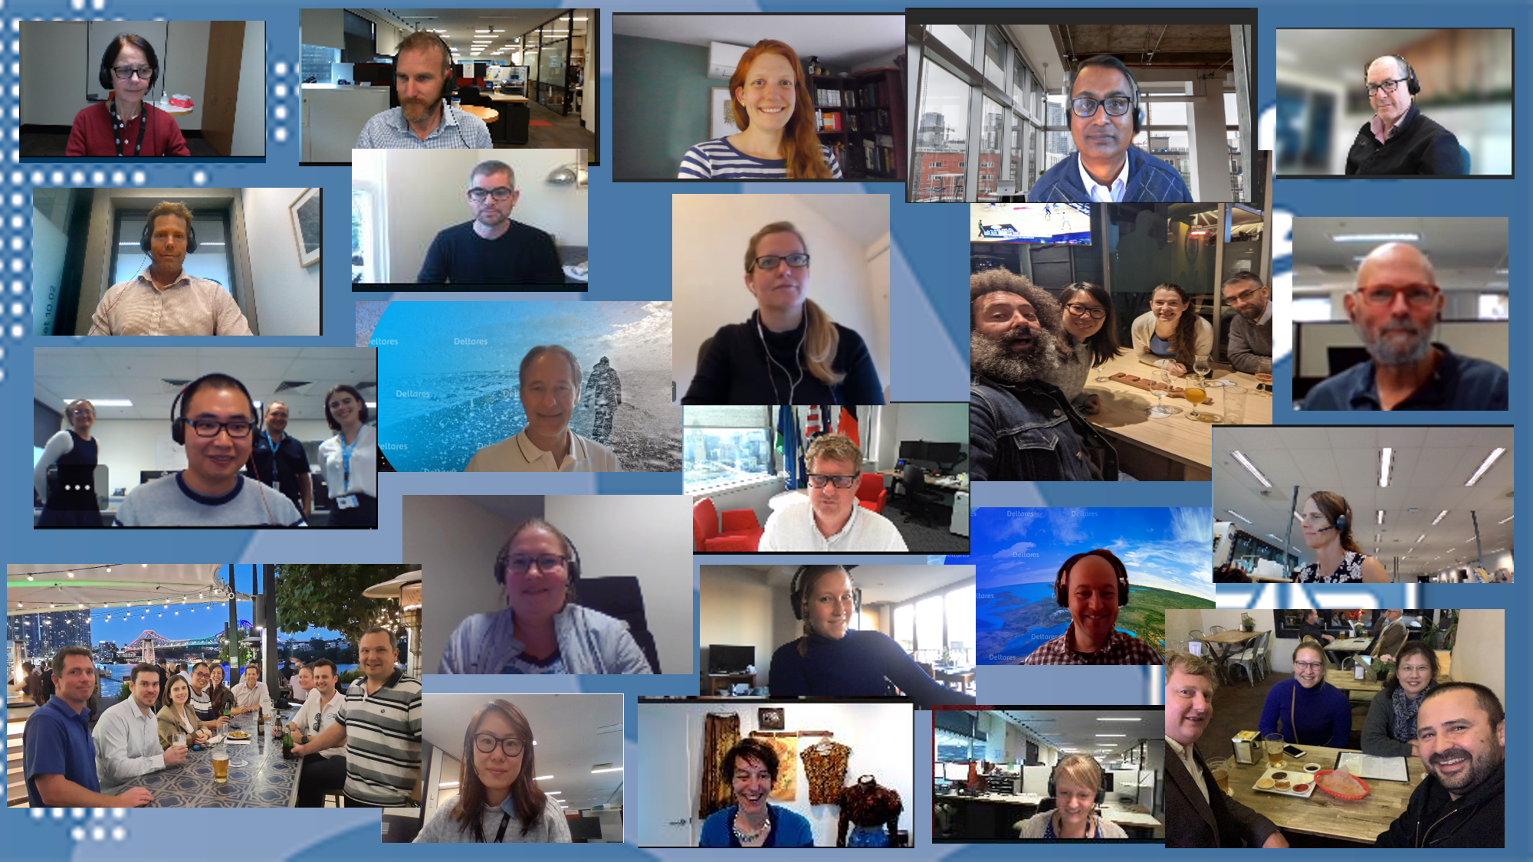
Welcome to the Delft-FEWS Community
Delft-FEWS Australian User Days 2014
Delft-FEWS Map of the world
Delft-FEWS International User Days 2019
Delft-FEWS International User Days 2021

Slide 2
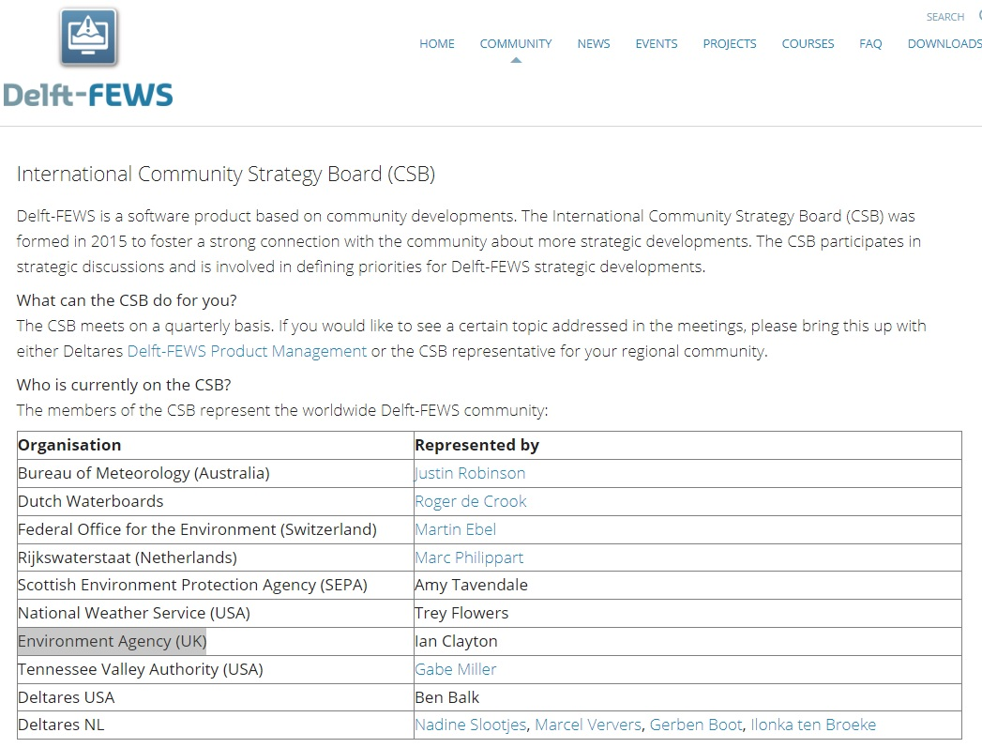
An initiative of the Delft-FEWS Community Strategy Board
Welcome (Ian Clayton - Environment Agency (UK)
Update on FEWS Releases and Plans (Gerben Boot – Deltares)
FEWS Talk (Gabe Miller – Tennessee Valley Authority (USA)
Community Breakout (The FEWS Community)

Slide 3
Gabe Miller
TVA FEWS System and the Open Archive
Photo: Jason O’Brien/EPA

Slide 4
Now to meet the community
Two questions to start the discussions
We’re interested in exploring what makes FEWS work for you as a user and for your organisation.
The Delft-FEWS community..
What is your favourite or most prominent feature in FEWS?
How does your organization use (or would like to use) the FEWS Archive?

