Slide 1
Delft-FEWS PM Update
FEWS community talk (08.06.2023)
Marcel Ververs
Gerben Boot
Delft-FEWS Product Management
Naam Achternaam

Slide 2
Table of contents
Organisational changes
Delft-FEWS release 2023.01
Community update
Roadmap 2023

Slide 3
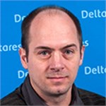
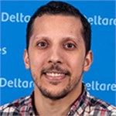
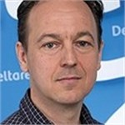
Delft-FEWS organisation
Delft-FEWS Community Talk (08.06.2023) – Update from FEWS-PM
Delft-FEWS Product Management Team
NEW Delft-FEWS Developers
Ilonka ten Broeke
focus: community
Michael Topsom
Started: November 2022
Gerben Boot
focus: developments
Anass Drif
Started: February 2023
Marcel Ververs
focus: support
fews-pm@deltares.nl
Notes:
PM team
New developers

Slide 4
Delft-FEWS 2023.01 Benchmarks planned: June 2023 – release notes
Delft-FEWS Community Talk (08.06.2023) – Update from FEWS-PM
±115 new features
Web OC configuration
± 150 bugs reported (100+ fixed)
Migrated to Java 17
11 new import modules
Many new and updated 3rd party libraries
13 new features in FEWS-webservices
10+ improvements to the open archive
WFS as a new service
Integration with Azure DevOps
Tomcat 10 migration
continuous improvements to what-if functionality
Notes:
NOG AANPASSEN - GB

Slide 5
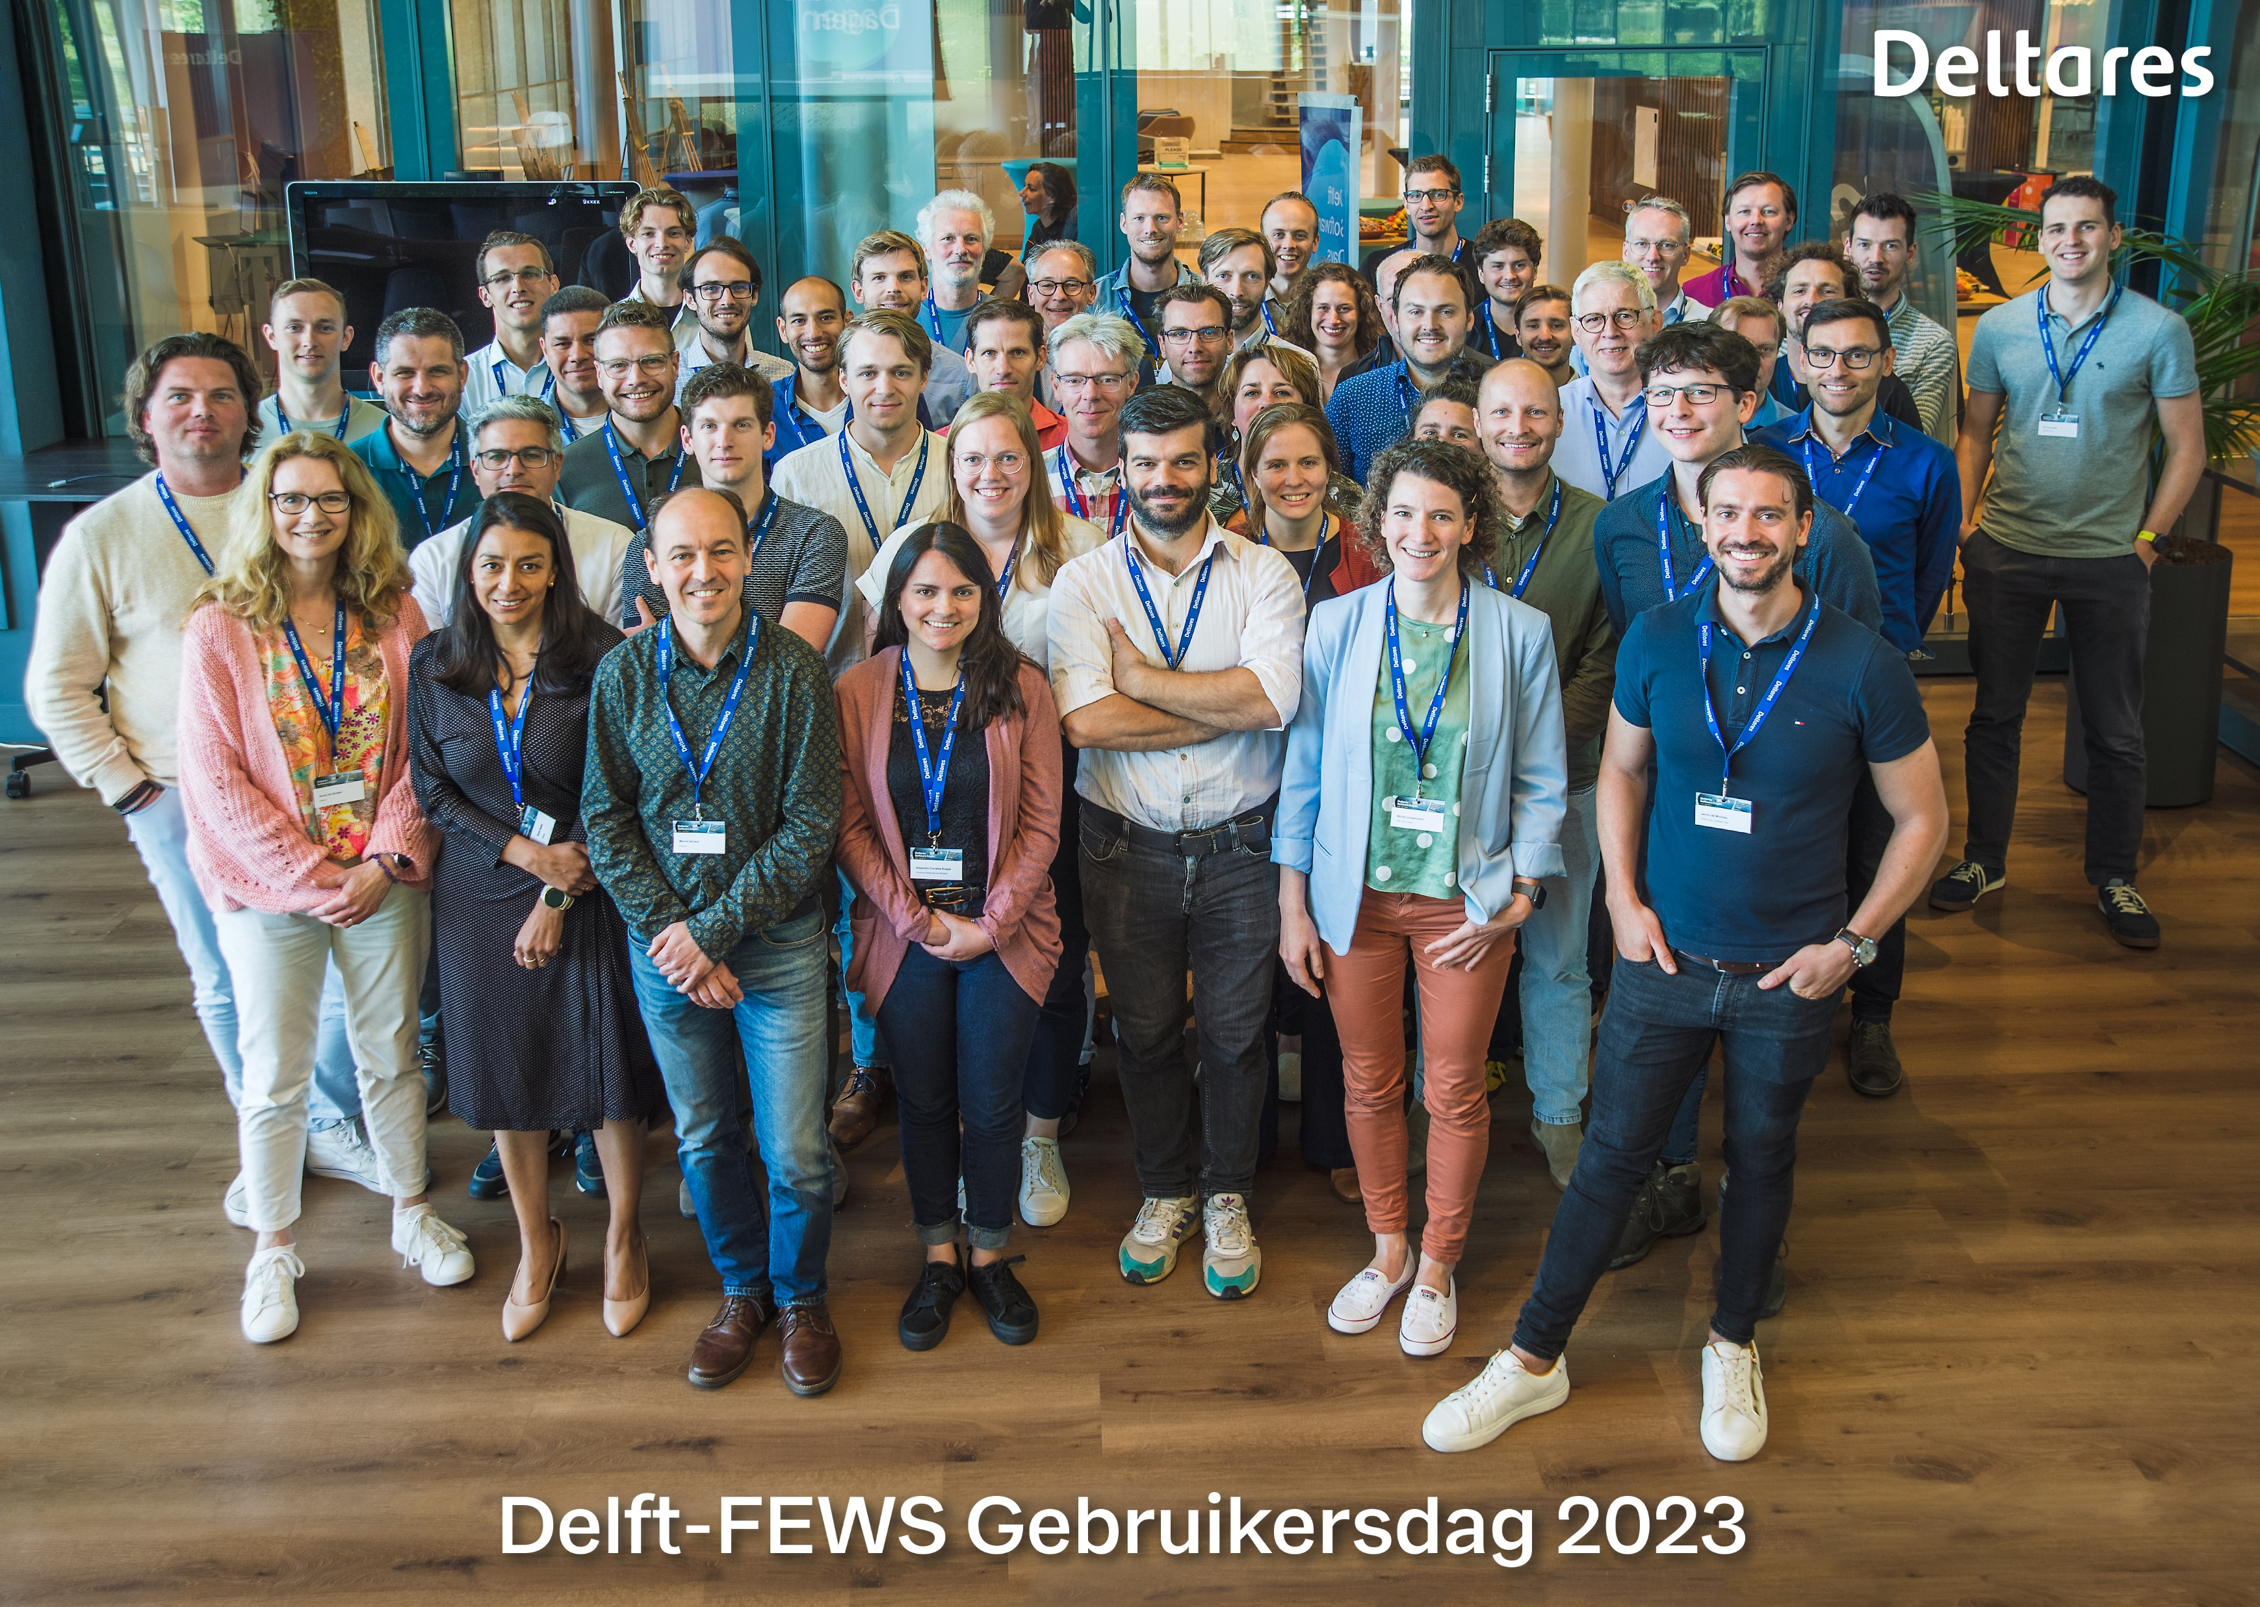
Community updates
Delft-FEWS Community Talk (08.06.2023) – Update from FEWS-PM
Delft-FEWS User Days (programmes and presentations)
Gebruikersdag Netherlands/Belgium: 6th of June 2023 (Delft, NL)
Anwendertreffen: 15th + 16th of June 2023 (Aachen, D)
Australia: 23rd - 25th of August 2023 (Brisbane, QLD)
International Delft-FEWS User Days: 8th+9th of November 2023 (Delft, NL)
Courses
Around User events
Schedule
Online events (recordings via portal)
Next webinar – 2023.01 new features: 14th of September 2023
Webinar 2022.02 features (March 2023)
Delft-FEWS NL User Meeting (June 2023)

Slide 6
Outlook Roadmap 2023
Delft-FEWS Community Talk (08.06.2023) – Update from FEWS-PM
Outline
Continuation:
Code clean-up & code quality
Release test automation
Security (2023.01)
Security Matrix + descriptive document
Connectivity Guide extended with security aspects
Admin Guide extended with security aspects
Python Integration
Archive Vision (Q3)
Start of preparation of the Delft-FEWS Vision 2025 successor
Notes:
AANPASSEN

Slide 7
Contact
www.delft-fews.com
@DelftFEWS
linkedin.com/company/deltares
fews-pm@deltares.nl
@deltares
facebook.com/deltaresNL
facebook.com/deltaresNL
linkedin.com/company/deltares
@deltares
@deltaresNL

